Slide 1

Siddi Sathvik Kuruba-AP23110010516
Ponnuru Naga Sai Yaswanth-AP23110010528
Ratan Raj-AP23110010515

Slide 2
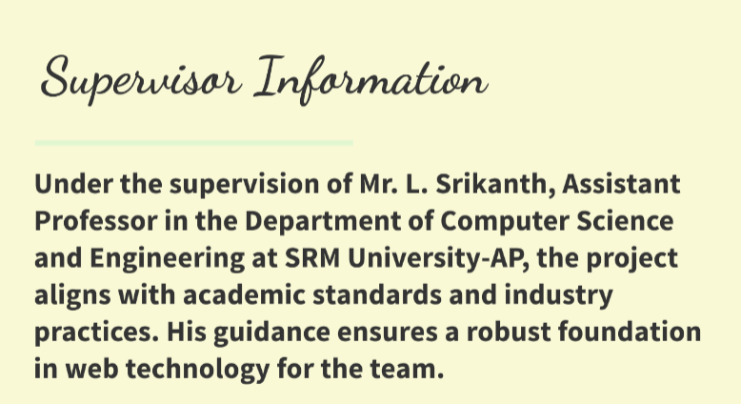

Slide 3



Slide 4


Slide 5


Slide 6
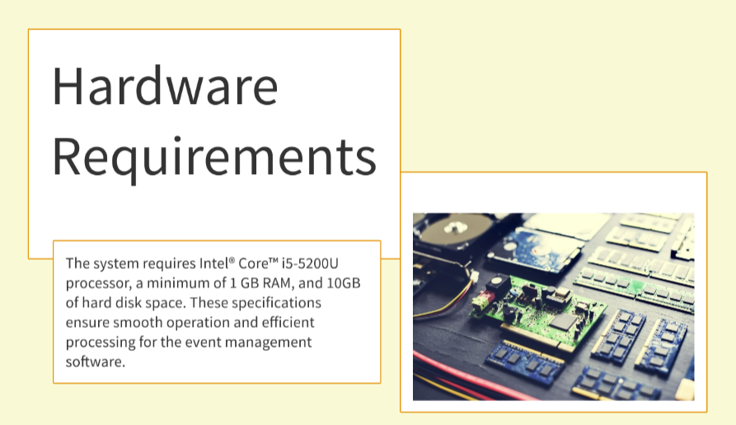

Slide 7
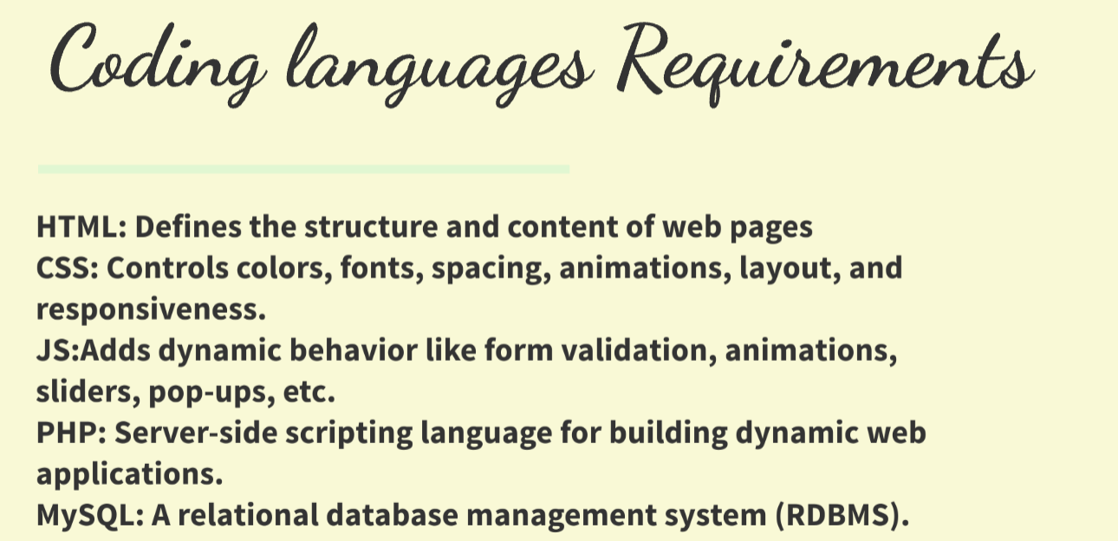

Slide 8

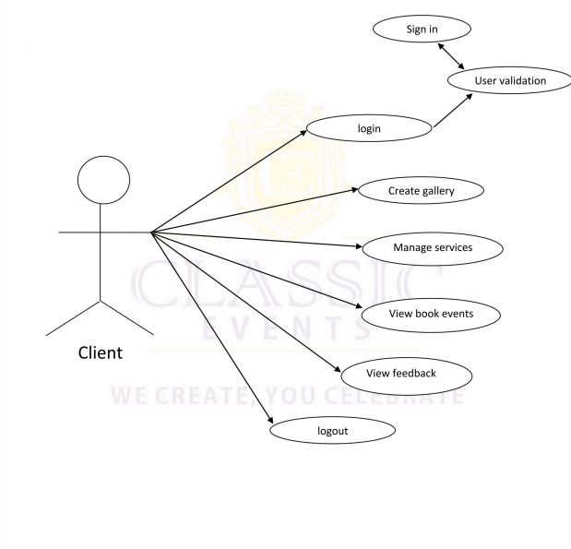

Slide 9

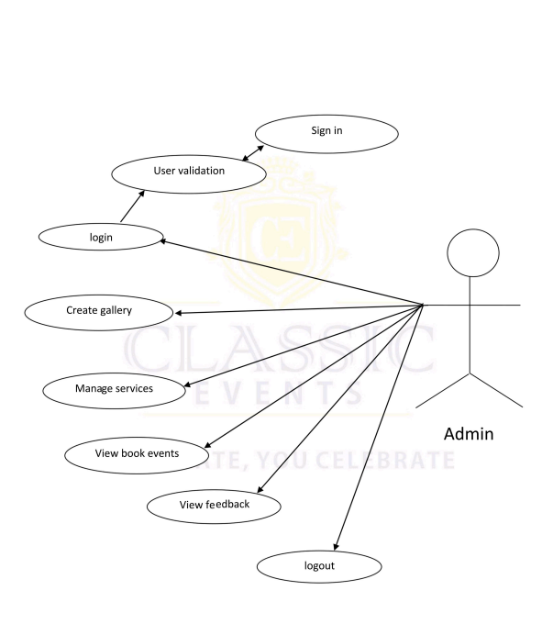

Slide 10


Slide 11


Slide 12


